Slide 1

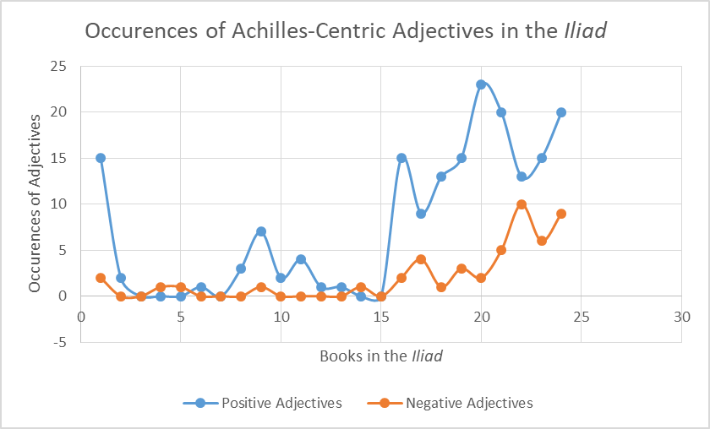
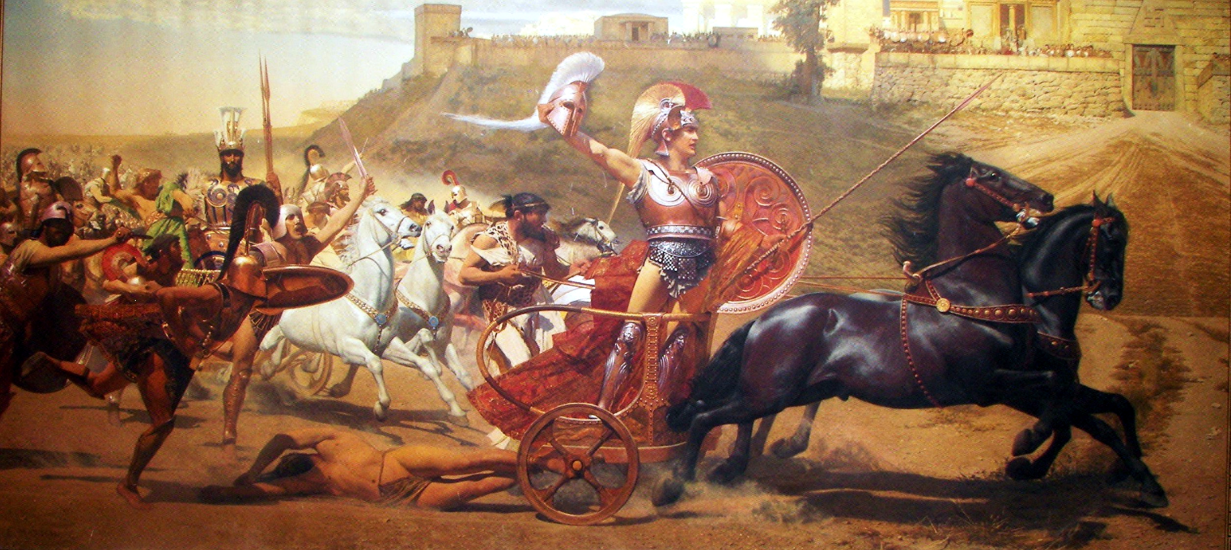
The Character of Achilles in the Iliad: A Digital Analysis Alex Kaminski Mt. Allison University
Hypothesis
As the greatest Greek warrior Achilles was beholden to many, friend and enemy alike. This makes for a wide variety of perceptions throughout the story. When observed, the data gleaned from the procedure can demonstrate an approximate perception of Achilles as he progresses through the story, and the war itself as he is centric to many of the conflicts. My prediction is that the more that Achilles fights perceptions will begin to skew in a less positive and more negative light as the horror of war and killing is regarded.
What is the Iliad?
The Iliad is an Ancient Greek epic poem written in dactylic hexameter, dated to 1260 – 1180 BC. It is set during the ten year siege of Troy (Ilium) by a coalition of Greek states under Agamemnon, King of Mycenae1. The story is set around the quarrels of Agamemnon and Achilles, the greatest warrior in Greece.
Themes
The Iliad portrays its characters grappling with several themes throughout, themes that can be indicative of traditional Greek hero values2. It portrays Fate, Pride, Wrath, but most importantly kleos (κλεος, “glory”) and nostos (νοστος, “homestead”). These are the two motivators for Greek warriors but Achilles must choose between them. If he participates in battle and earns kleos, it will eventually grant him kleos aphthiton (“imperishable glory”), which for the Greeks is akin to immortality. Nostos represents the peace that warriors return to, it too is a reward but it naturally requires them to live, which becomes more difficult with participation in battle.
Procedure
The Iliad was downloaded from the Perseus Project3 in XML. It was separated into its 24 books and examined with a program written in python script that utilized a Natural Language Processor. The program identified all sentences that mentioned Achilles and compared the adjectives associated with him to a list of positive and a list of negative ones. If the adjective matched any of the words in either list it was counted as either a positive or negative occurrence. For each book the program returned a total for positive and negative adjectives, which can then be subject to interpretation.
Figure 1
Results
While they almost never surpassed the positive descriptors, the negative adjectives describing Achilles gradually increased as the Iliad progressed. Achilles remained an admired character throughout but his more infamous nature was revealed in his plotline. Significant data points (n.b. Fig. 1) observed were found to be consistent with events in the plot.
Point 1, Positive Spike: Achilles pressures Agamemnon to return a captive Trojan girl to alleviate a plague caused by Apollo, whom she worships. After nine days Agamemnon relents and returns his captive but not without exacting a toll on Achilles by demanding his captive, Briseis, as compensation.
Point 16, Positive Spike: For Agamemnon’s slight, Achilles had declared that he and his warriors would no longer participate in the conflicts. When the Trojans attacked their victory was almost assured until Patroclus led a rallying Greek force wearing Achilles’ armour (which may be cause for a margin of error, certain words may have been in reference to Patroclus in Achilles’ armor, not Achilles himself).
Point 17, Positive Dip/ Negative Spike: Hector removes Achilles’ armour from Patroclus and fighting develops around his body.
Point 20, Positive Spike: After learning of the death of his cousin Achilles rides into battle and slays many Trojans. Agamemnon returns Briseis to him but he is indifferent now.
Point 22, Positive Dip/Negative Spike: Achilles kills Hector in single combat and then dishonors his corpse by tying it to his chariot and dragging it behind him.
Point 24, Positive Spike/Negative Spike: Achilles continues to abuse Hector’s body. Priam, the King of Troy, comes to him in secret and begs for the body of his son so that he may receive proper burial rites. Achilles is moved to tears, letting go of his anger he agrees and allows Priam to take Hector’s body.
Conclusion
I was able to prove that the frequency of negative words increased over the course of the Iliad, but they did not surpass the positive words (save books 4 and 5). The growth in negative words reveals growing discontent with Achilles and the Trojan War, while his feats and prowess earn him greater renown, even at his lowest moment (Book 22).

